Slide 1
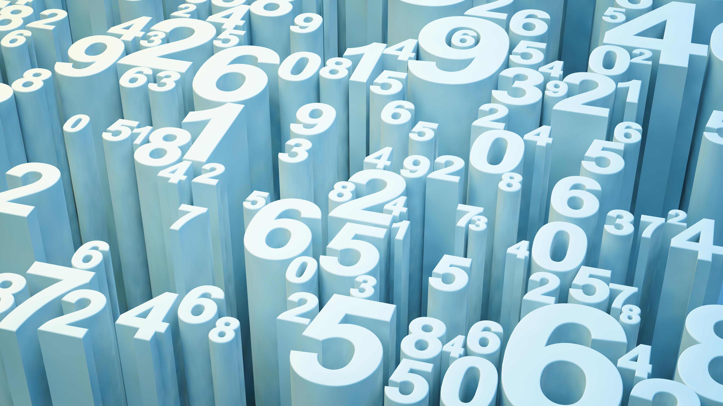
Python for Data Analytics- Project

Slide 2
Title Data analysis on a merged dataset after cleaning
Objective:
The primary goal of the analysis is to merge and clean datasets related to energy indicators, GDP, and journal contributions in the field of Energy Engineering and Power Technology. The resulting DataFrame will be used for data analysis and derive insights related to GDP, energy supply, renewable energy, and population estimates.
Insights:
The study aims to investigate the association between energy and economic indicators using three datasets: population forecasts, economic indicators, and energy supply.
The study performs computations, transformations, and analyses on the datasets to extract information of various components, including GDP growth rate, energy consumption, share of renewable energy, contribution to scientific research, and population estimates.
The study provides a comprehensive understanding of the relationship between energy supply per capita and Citable Documents per capita by combining datasets and employing statistical techniques.
The insights derived from the analysis aim to shed light on the impacts of energy and economic factors on different countries and continents.

Slide 3
Description of Datasets and Variables in the project
Energy Dataset
EnergyIndicators.xlsx
World Bank Dataset
world_bank.csv
Scimagojr Dataset
Scimagojr-3.xlsx
"Environmental Indicators: Energy" is a dataset that focuses on "Energy Supply and Renewable Electricity Production in 2013." The key indicators provided for each country include:
Country: The name of the country for which the energy data is presented.
Energy Supply (Petajoules): This is the total energy supply for the selected country in the year 2013, measured in petajoules (PJ). Petajoule is a unit of energy equal to one quadrillion joules.
Energy Supply per Capita (Gigajoules): This represents the amount of energy supplied per capita, indicating the average energy availability per person. It is measured in gigajoules (GJ). A gigajoule is equal to one billion joules.
Renewable Electricity Production (%): This indicates the percentage of electricity production that comes from renewable sources. It provides insights into the country's reliance on renewable energy.
Source:-(http://unstats.un.org/unsd/environment/excel_file_tables/2013/Energy%20Indicators.xls)
The World Bank dataset, sourced from the World Development Indicators, provides information on the Gross Domestic Product (GDP) at market prices measured in constant 2010 US dollars for various countries. The data includes the following columns:
Country Name: The name of the country for which GDP data is reported.
Country Code: A unique code assigned to each country.
Indicator Name: The type of economic indicator, which, in this case, is "GDP at market prices (US$)."
Indicator Code: A unique code associated with the economic indicator.
Year Columns (1960-2015): The dataset includes columns for each year from 1960 to 2015, providing the GDP values(in US$) for those respective years.
The dataset shows the GDP values for specific countries over the specified time period. Each row represents a country, and the corresponding GDP values are presented in US dollars. This dataset allows for the analysis of economic trends, growth, and comparisons between countries based on their GDP performance.
Source: (http://data.worldbank.org/indicator/NY.GDP.MKTP.CD).
The Scimago Journal and Country Rank of Energy Engineering and Power
Technology dataset provides information on the scientific research output of various countries in the field of Energy Engineering and Power Technology. Here's a brief description of the columns:
Rank: The ranking of the country based on its scientific research output.
Country: The name of the country.
Documents: Total number of scientific documents published.
Citable documents: Number of documents that are considered citable, contributing to the country's scholarly impact.
Citations: Total number of citations received by the country's scientific documents.
Self-citations: Number of citations that come from the country's own documents.
Citations per document: Average number of citations received per scientific document.
H index: The Hirsch index, a metric that quantifies both the productivity and impact of a country's scientific research output. The H-index provides a balance between the quantity (number of publications) and impact (citation counts) of an individual's work.
The dataset shows the top-ranking countries in terms of their scientific contributions in the specified field. It includes key metrics such as the number of documents, citations, and the H index, offering insights into the research impact and influence of each country.
Source: (http://www.scimagojr.com/countryrank.php?category=2102)

Slide 4
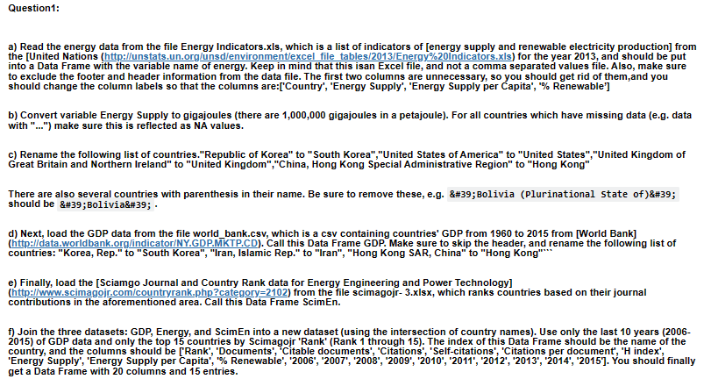
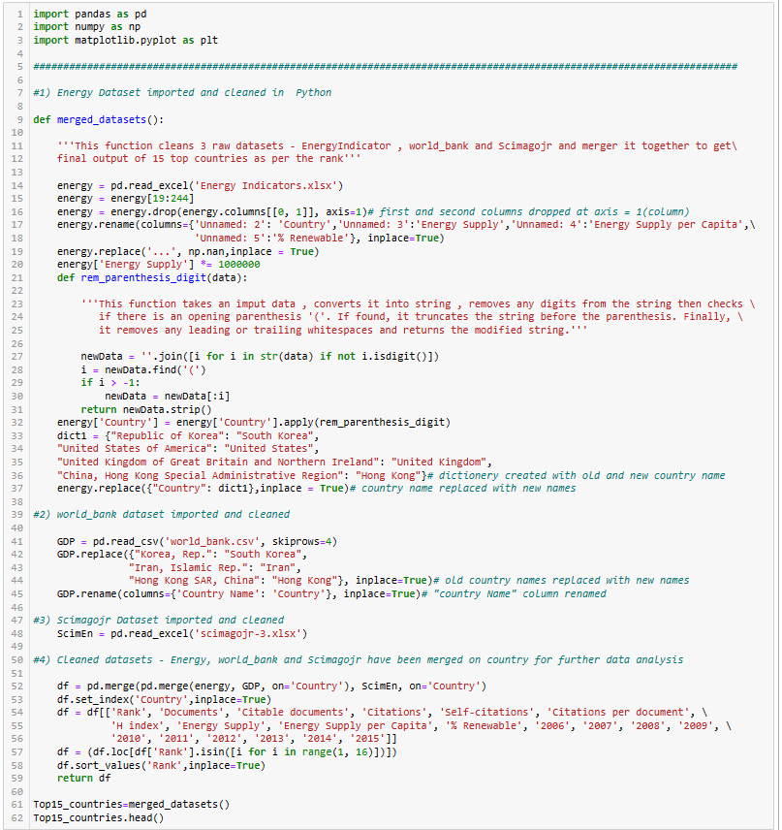
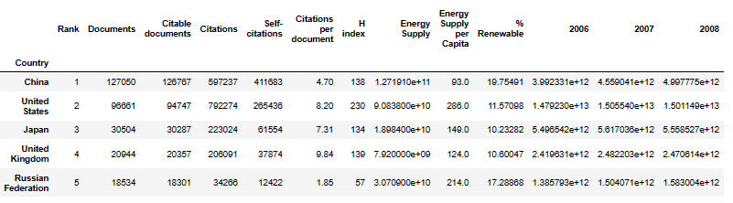
Data Analysis
Q1)
Output:

Slide 5
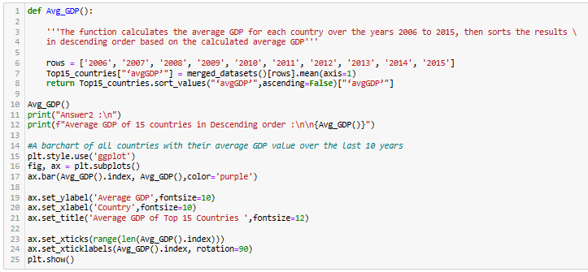
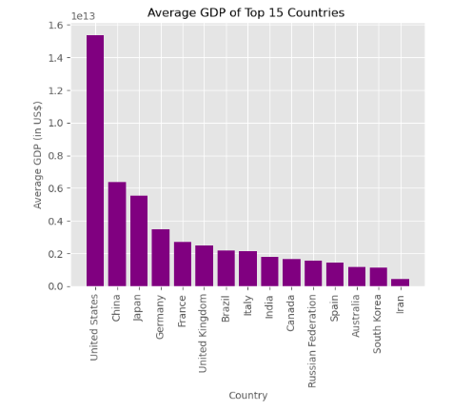
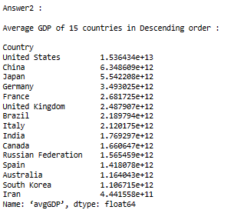
Data Analysis
Question 2: What are the top 15 countries for average GDP over the last 10 years? [NB: This function should return a Series named ‘avgGDP’ with 15 countries and their average GDP sorted in descending order.]
Output:

Slide 6
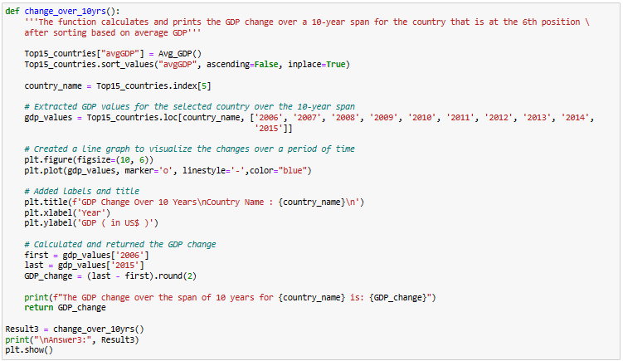
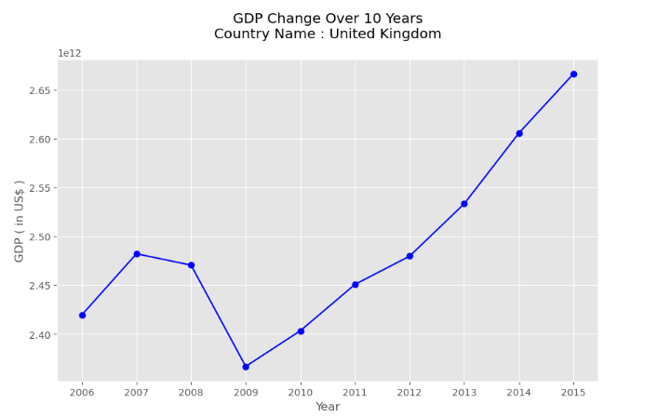
Data Analysis
Question 3 : By how much had the GDP changed over the 10 year span for the country with the 6th largest average GDP? [NB: This function should return a single number.]
Output:

Slide 7
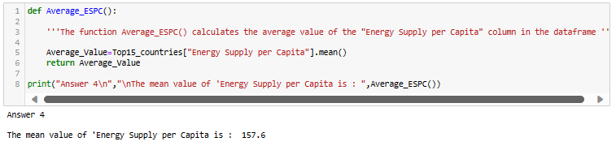
Data Analysis
Question 4 : What is the mean energy supply per capita? [NB: This function should return a single number.]

Slide 8
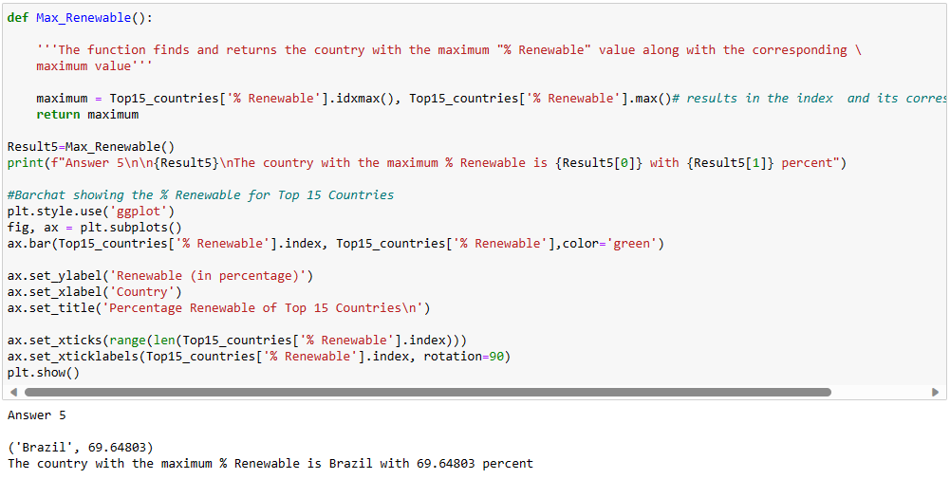
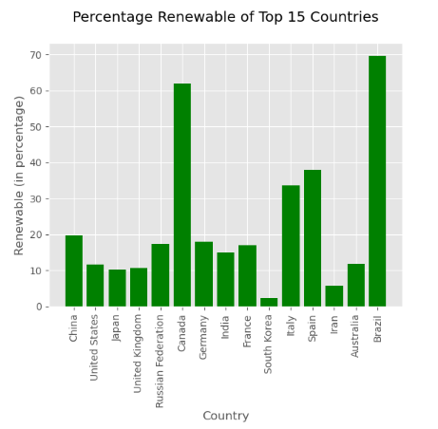
Data Analysis
Question 5 : Which country has the maximum % Renewable and what is the percentage? [NB: This function should return a tuple with the name of the country and the percentage.]

Slide 9
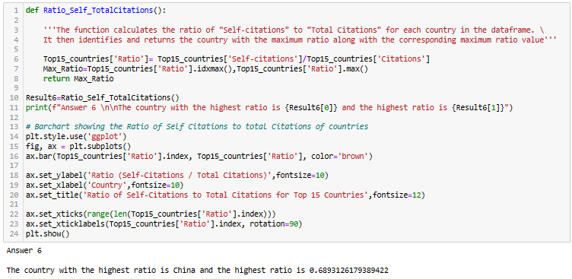
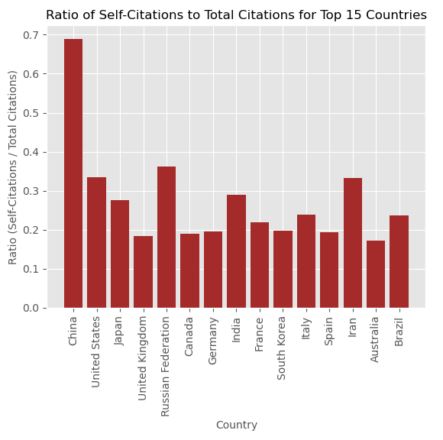
Data Analysis
Question 6 : Create a new column that is the ratio of Self-Citations to Total Citations. What is the maximum value for this new column, and which country has the highest ratio? [NB: This function should return a tuple with the name of the country and the ratio.]¶

Slide 10
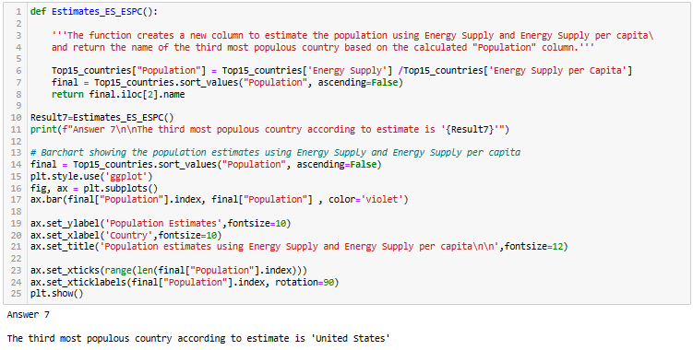
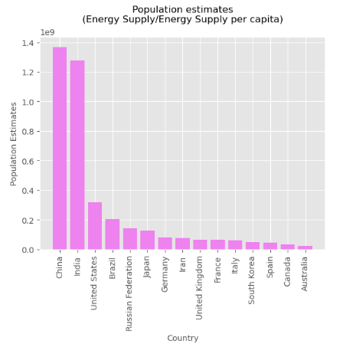
Data Analysis
Question 7 : Create a column that estimates the population using Energy Supply and Energy Supply per capita. What is the third most populous country according to this estimate? [NB: This function should return a single string value.]

Slide 11
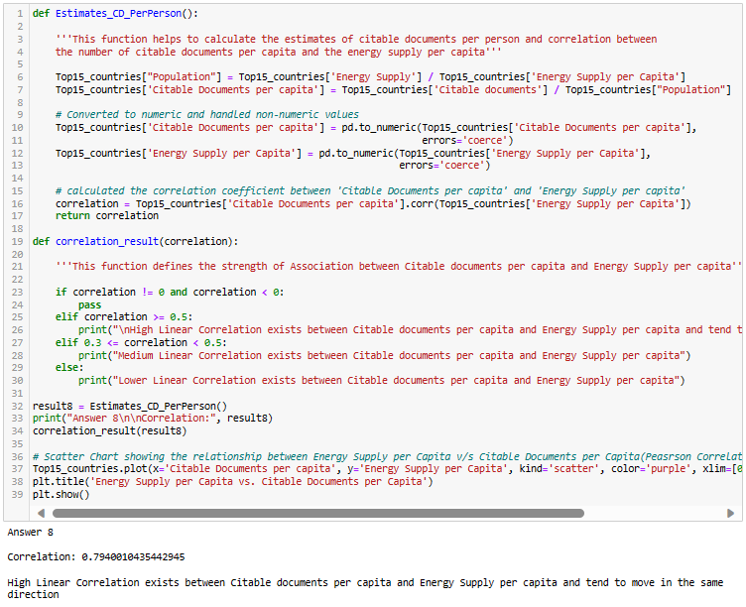
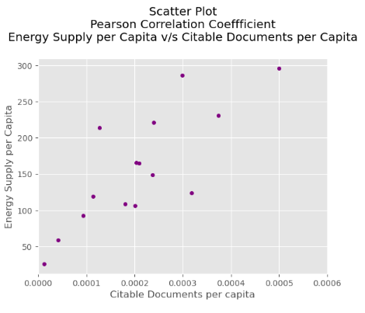
Data Analysis
Question 8 : Create a column that estimates the number of citable documents per person. What is the correlation between the number of citable documents per capita and the energy supply per capita? Use the “.corr()” method, (Pearson's correlation). [NB: This function should return a single number.] Plot to visualize the relationship between Energy Supply per Capita vs. Citable docs per Capita.

Slide 12
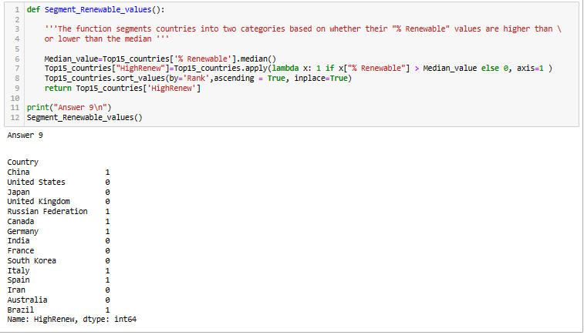
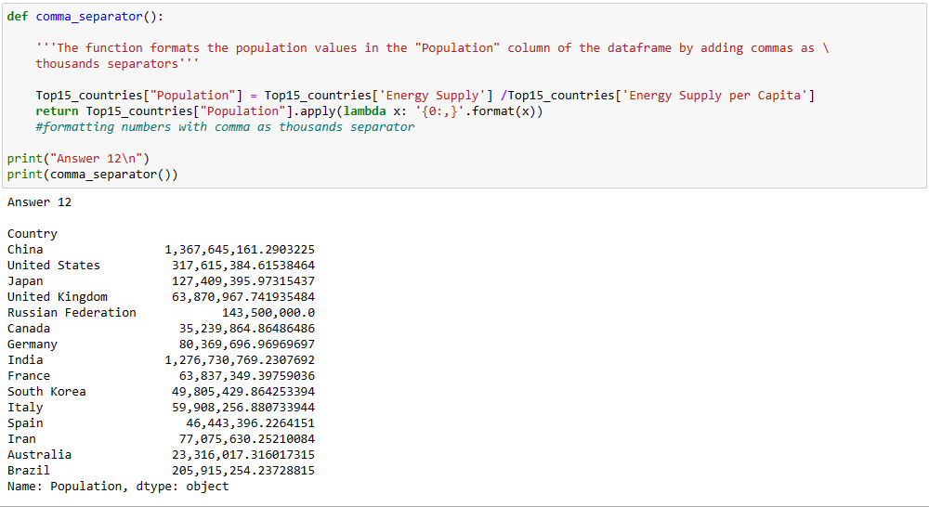
Data Analysis
Question 9 : Create a new column with a 1 if the country's % Renewable value is at or above the median for all countries in the top 15, and a 0 if the country's % Renewable value is below the median. [NB: This function should return a series named “HighRenew” whose index is the country name sorted in ascending order of rank.]
Question 12 : Convert the Population Estimate series to a string with thousands separator (using commas). Do not round the results. e.g. 317615384.61538464 -> 317,615,384.61538464

Slide 13
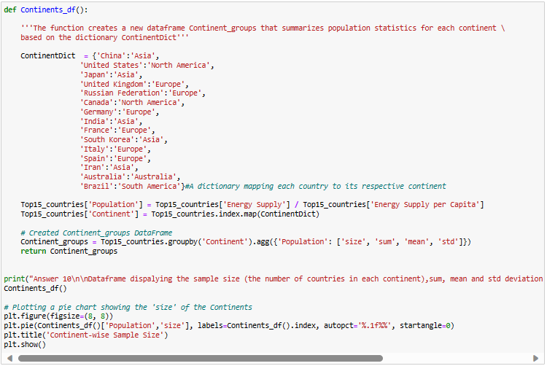
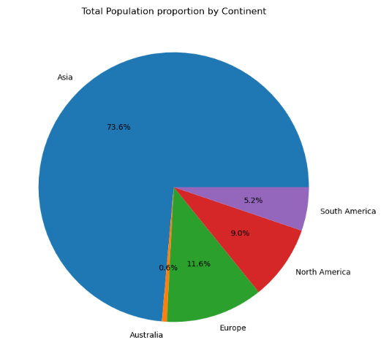
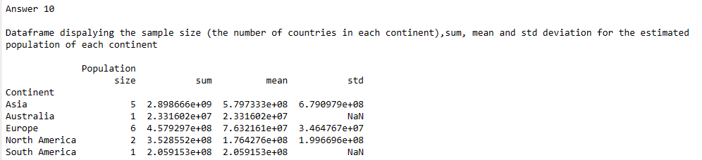
Data Analysis
Question 10 : Use the following dictionary to group the Countries by Continent, then create a DataFrame that displays the sample size (the number of countries in each continent bin), and the sum, mean, and std deviation for the estimated population of each continent.
[NB: This function should return a DataFrame with index named Continent ['Asia', 'Australia', 'Europe', 'North America', 'South America'] and with columns ['size', 'sum', 'mean', 'std'].]

Slide 14
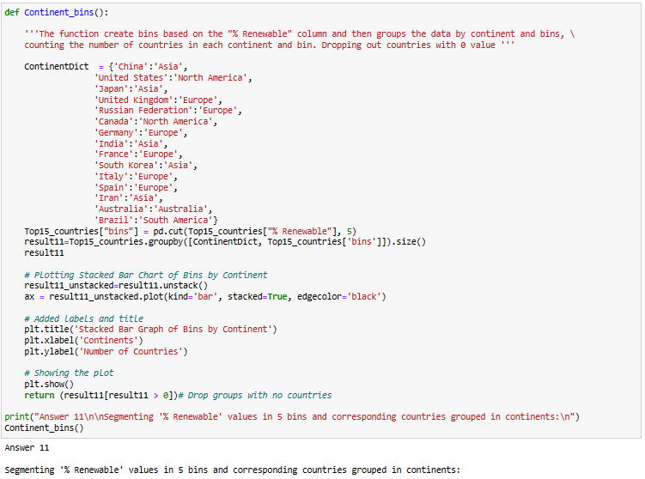
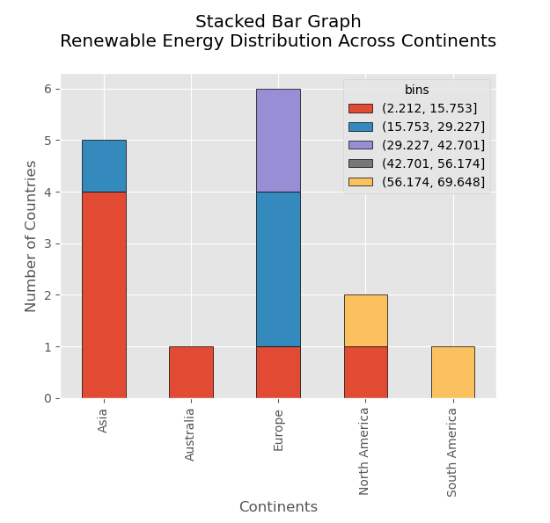
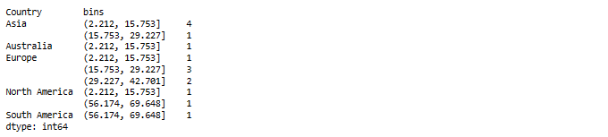
Data Analysis
Question 11 : Cut % Renewable into 5 bins. Group Top15 by the Continent, as well as these new % Renewable bins. How many countries are in each of these groups? [NB: This function should return a Series with a MultiIndex of ‘Continent’, then the bins for ‘% Renewable’. Do not include groups with no countries.]

Slide 15
Key Findings
China has highest average GDP ranked at 1st position and Brazil at 15th position from Top 15 countries
Top 2 countries with the maximum percentage renewable is Brazil and Canada . This indicates the percentage of electricity production that comes from renewable sources are highest in these countries which belongs North America and South America Continents
The country with the highest Citation ratio is China. The country cites maximum its own work as compared to all other countries
As per the Population Estimates (using Energy Supply and Energy Supply per capita), the most populous country is China at 1st position, India at 2nd and United States at 3rd
As per Pearson Correlation Coefficient , high linear correlation exist between citable documents per capita and energy supply per capita and tend to move in the same direction. An increase in one tends to be associated with an increase in the other, and vice versa
A new column "HighRenew" indicates that the country with value 1, has a high percentage of renewable energy (% Renewable > Median_value), while a value of 0 indicates the opposite

Slide 16
Recommendations
Energy Efficiency Programs: The countries with higher population estimates should implement energy efficiency programs to optimize energy consumption. This can help in sustaining the higher population without excessively increasing the demand for energy resources.
Positive correlation between Energy Supply per capita and Citable documents per capita can be valuable for countries seeking to enhance their global competitiveness in research, innovation, and sustainable energy development.
Research and Development: The countries with % Renewable value lower than median should allocate resources to research and development initiatives aimed at improving renewable energy technologies. This can involve collaboration with academic institutions, private sectors, and international organizations to foster innovation.
The continents with lower percentage of renewable energy , like Asia could consider increasing investments in renewable energy projects and should diversify their renewable sources .

Slide 17
Thank You

